Slide 1
Bash Commands/scripting
Preonath Chondrow Dev
Bioinformatician
Child Health Research Foundation

Slide 2
Listing commands
ls -l: Displays detailed information about files and directories, including permissions, ownership, size, and modification time.
ls -a: Lists all files, including hidden files that start with a dot (e.g., .bashrc).
ls -h: Shows file sizes in human-readable format, such as "K" for kilobytes or "M" for megabytes.
ls -t: Sorts files by modification time, with the most recently modified files appearing first.
ls -S: Sorts files by size, with the largest files appearing first.
ls -d: Lists only directories.
ls -1: Displays each file on a separate line.
ls -lhtr: Lists files in the current directory sorted by modification time in reverse order, with detailed information and sizes displayed in human-readable format.
ls -Rl: Recursively lists files and directories in the current directory and its subdirectories, with detailed information.

Slide 3
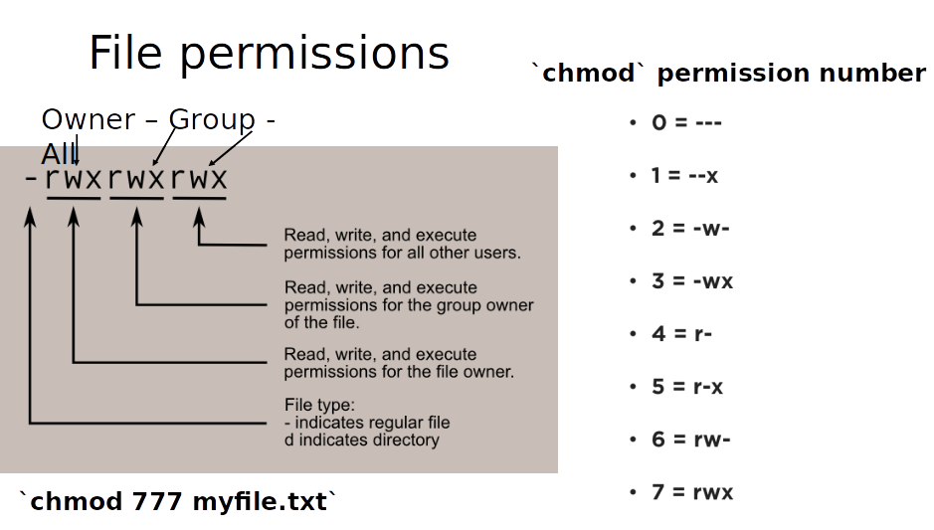
File-permission commands
chmod 777 file: set read(r) write(w) and execute(x) for all users
chmod 755 file: set owner to rwx and all other users to rx
chmod 766 file: set owner to rwx and all other users to rw
chmod 644 file: set owner to rw and all other users to r
chmod +x file: make file executable for all users
chown user file: change the owner of file to user

Slide 4
Viewing file content
cat: Displays the entire content of a file.
Example: cat file.txt
more: Displays the file content one page at a time.
Example: more file.txt
less: Allows you to navigate through the file content using arrow keys or specific commands.
Example: less file.txt
tail: Shows the last few lines of a file.
Example: tail file.txt
By default, tail displays the last 10 lines. You can use the -n option to specify a different number of lines.
head: Shows the first few lines of a file.
Example: head file.txt
By default, head displays the first 10 lines. You can use the -n option to specify a different number of lines

Slide 5
Text processing (in/from file)
cut:
cut is used to extract specific columns or fields from a file or input stream.
It allows you to define the delimiter character or field position for extraction.
Example: cut -f 2,4 -d ',' file.txt (extracts the 2nd and 4th fields delimited by comma)
sort:
sort is used to sort lines of text in ascending or descending order.
Example: sort file.txt (sorts the lines alphabetically)
grep:
grep is used for pattern matching and searching for specific lines in files or input streams.
Example: grep 'pattern' file.txt (searches for lines containing the pattern)

Slide 6
Text processing (in/from file)
sed:
sed is a stream editor used for text transformation and manipulation.
It can perform various operations on text, such as search and replace, deletion, insertion, and more.
Example: sed -i 's/pattern/replacement/g' file.txt (replaces all occurrences of the pattern with the replacement)
awk:
awk is a powerful text processing language for extracting and manipulating data.
It allows you to define patterns and associated actions to perform on matching lines or fields.
It can perform calculations, conditional statements, and other operations on the data.
Example: awk '{print $1}' file.txt (prints the first field of each line)

Slide 7
Compression Commands
tar -cf file.tar files: create a tar named file.tar containing files
tar -xf file.tar: extract the files from file.tar
tar -czf file.tar.gz files: create a tar with Gzip compression
tar -xzf file.tar.gz: extract a tar using Gzip
tar -cjf file.tar.bz2 files: create a tar with Bzip2 compression
tar -xjf file.tar.bz2: extract a tar using Bzip2
gzip file: compresses file and renames it to file.gz
gzip -d file.gz: decompresses file.gz back to file

Slide 8
Thank you

